Slide 1
Getting Started With Typing Web
Educational Technology 101

Slide 2
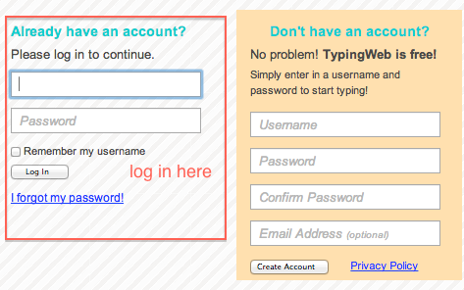
Login and Password
Type typingweb.com in your browser’s address bar OR click the link under Class Tools
Your login looks like this:
Username: firstname.lastname
just like your Gmail
Password: 12345
For example - tyrell.mason

Slide 3
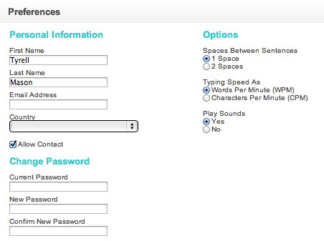
Change Your Password
Click on Preferences after logging in
Make your new password the same as your Gmail password – it’s easier to remember!

Slide 4
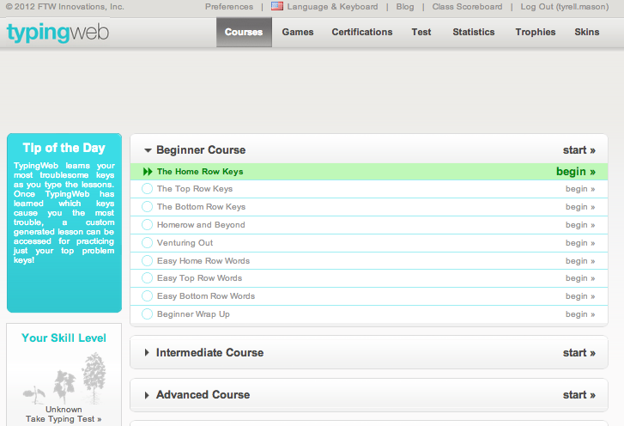
Start with “The Home Row Keys”

Slide 5
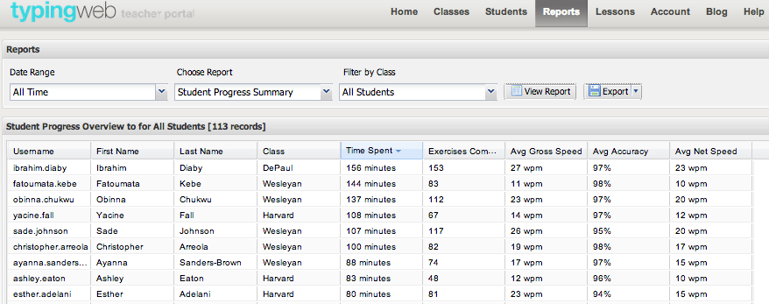
Progress Tracking

Slide 6
Check for Understanding
What is your username? What is your password?
What should you change your password to?
After changing your password, what do you work on?
Can you practice Typing Web at home?

